Slide 1
Determinants of GDP
Sami Naeem
Brandon Latherow
Samuel Farrell

Slide 2
Project Description
This project aims to analyze the impact of social and economic factors, using econometric and machine learning models, on GDP growth rate per capita. We used the World Bank Open Data to obtain data on various social and economic metrics on the Latin America and Caribbean region. We studied the impact of these factors on economic growth (GDP growth rate per capita) from 1993 to 2019. Additionally, we used the econometric and machine learning models to forecast future gdp growth rate per capita.

Slide 3
Data Set
Independent Variable:
GDP per Capita Growth (Annual %)
Dependent Variables:
Access to Electricity (% of Population)
Labor Force Participation Rate(% of Population - National Estimate)
Labor force participation rate (female%)
Labor force participation rate (male%)
Literacy Rate (% of Population)
Literacy rate (adult female)
Literacy rate (youth female)
Literacy rate (adult male)
Literacy rate (youth male)
Life Expectancy at Birth (Years)
Life expectancy at birth (female)
Life expectancy at birth (male)
Net Migration (Persons)
School Enrollment, Primary (% Net)

Slide 4
Data Collection, Cleanup, and Exploration
The World Bank DataBank was used since its a rich source of data for Global Economic and Social Development indicators
We used data from 1993 - 2019 to remove missing data points. Data collection and calculation constraints on World Bank’s end did not allow us to use older data.
The data was exported from the World Bank DataBank, formatted in excel and finally saved as a CSV to be used for analysis.

Slide 5
Data Trends Visualizations

Slide 6
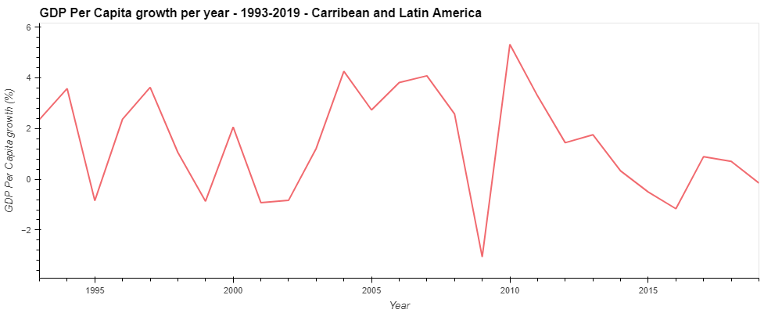

Slide 7
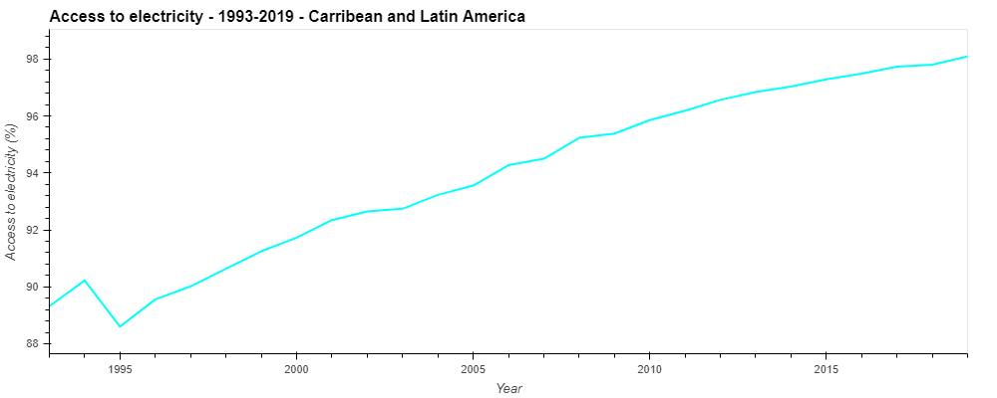
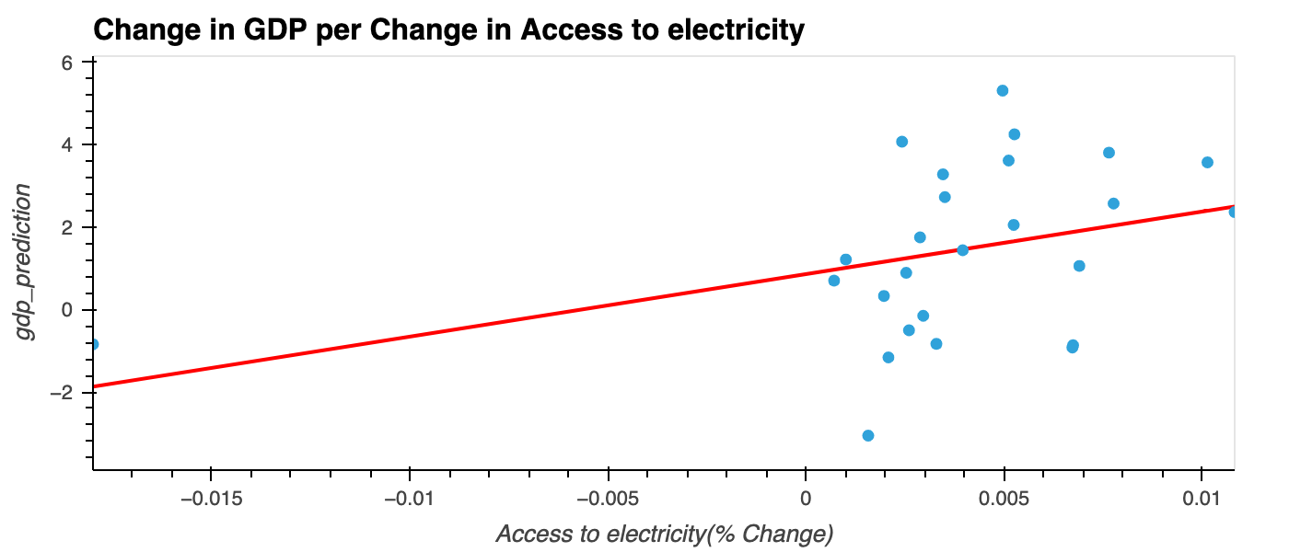

Slide 8
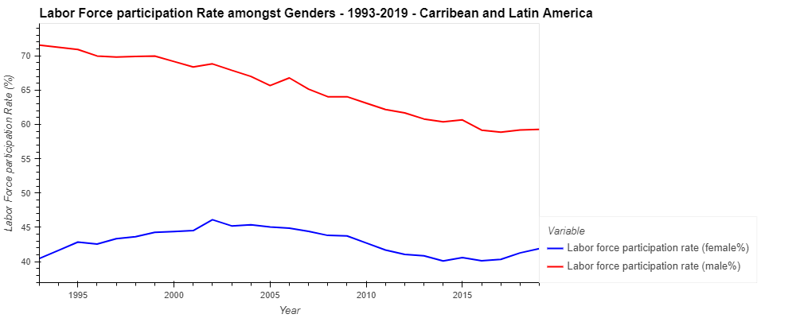
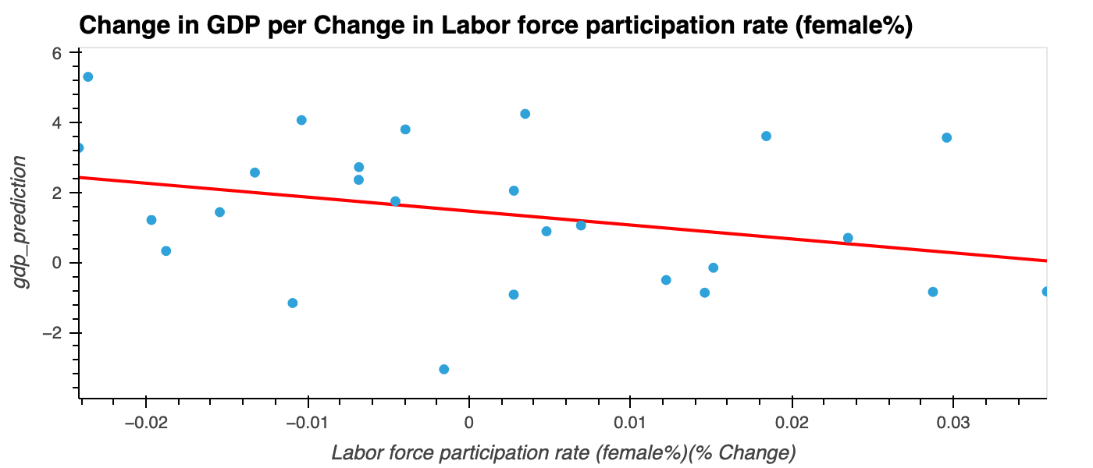
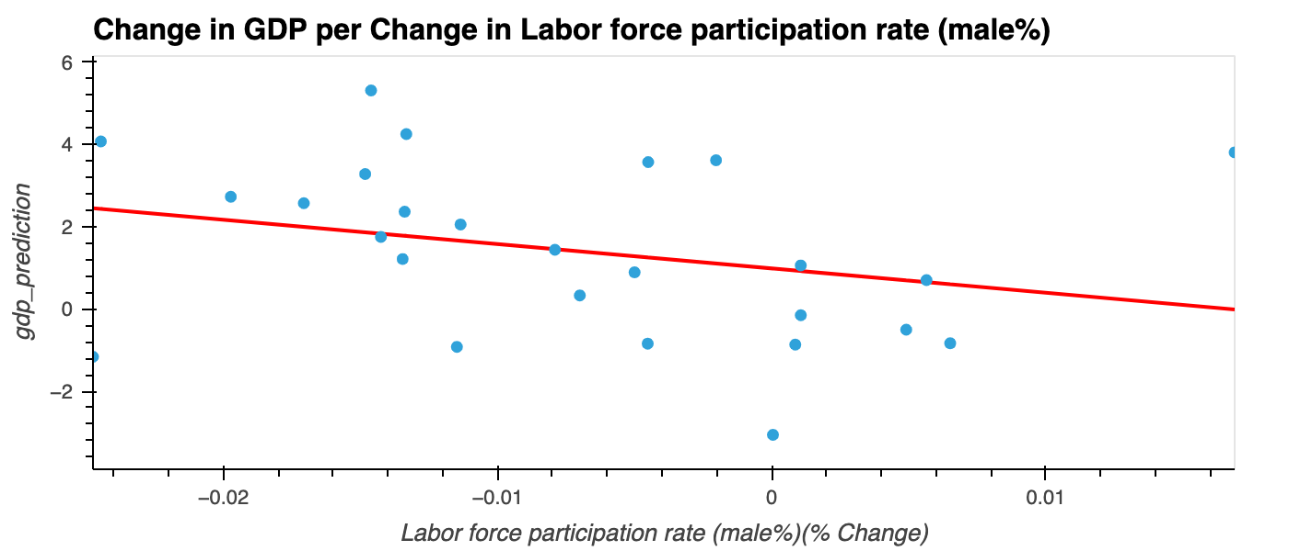

Slide 9
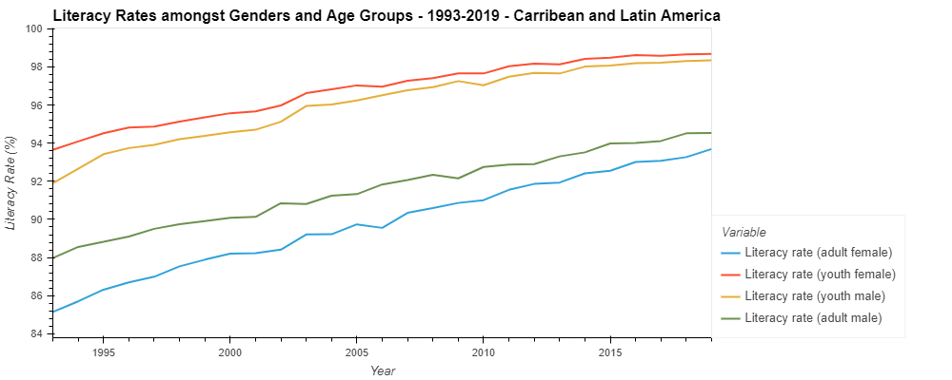
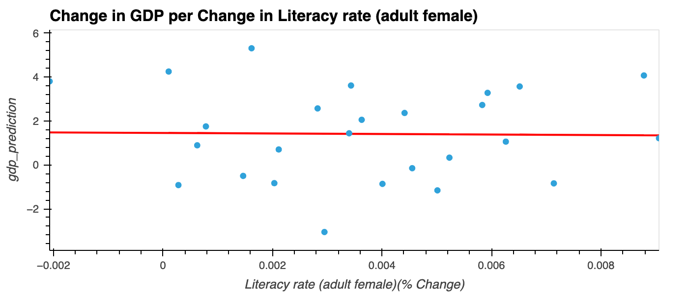
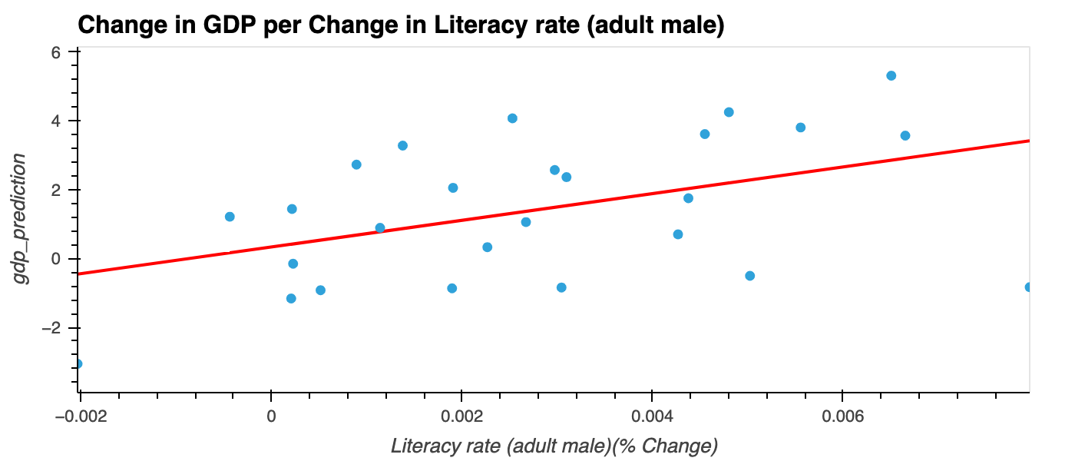
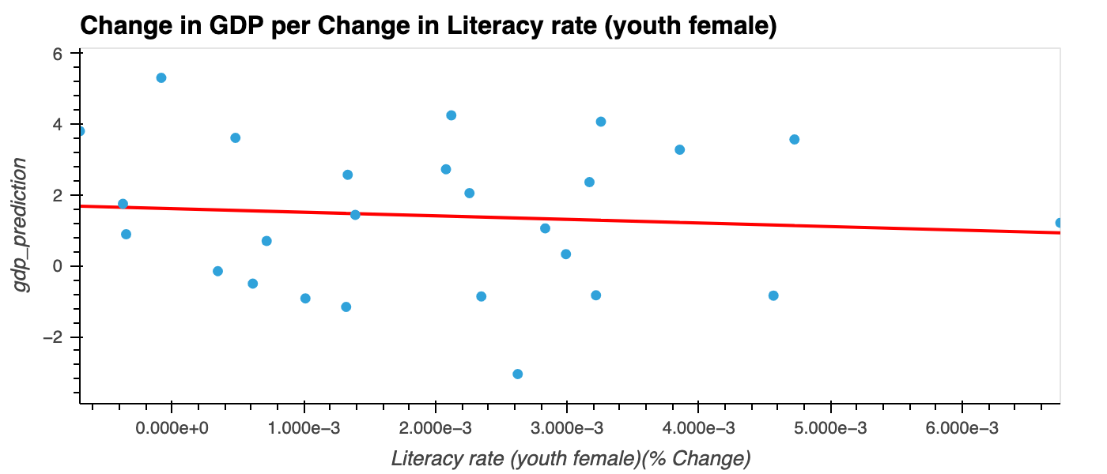
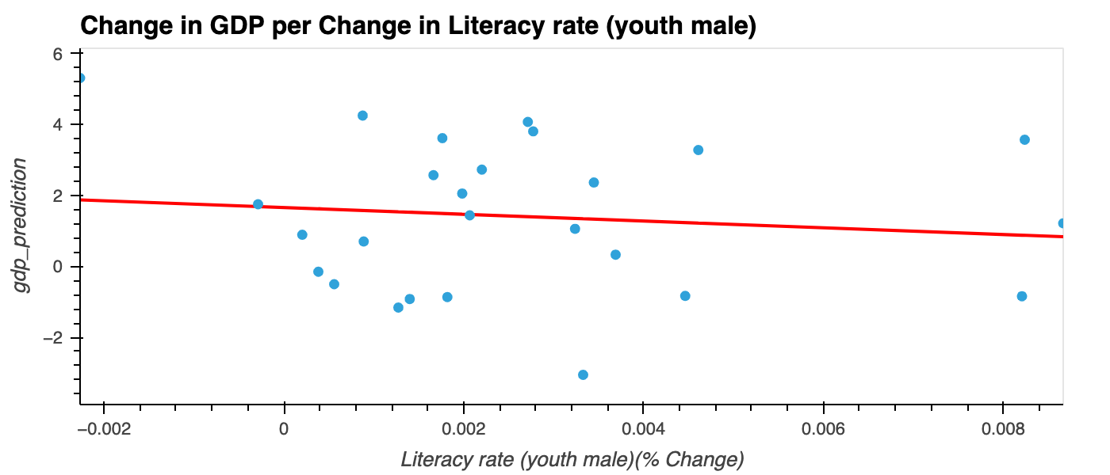

Slide 10
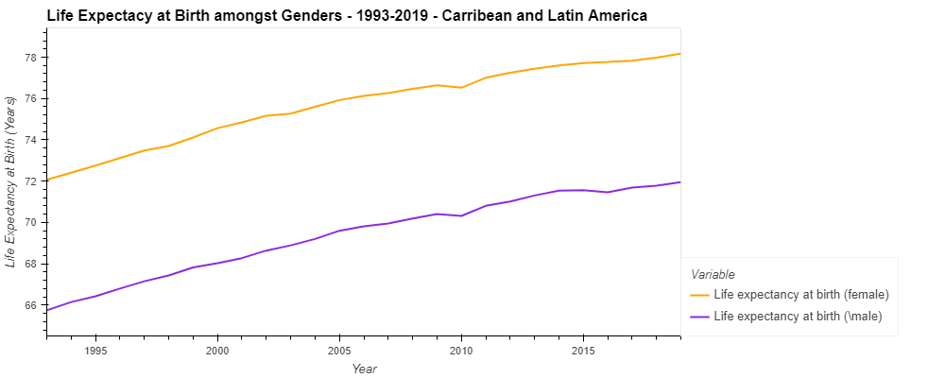
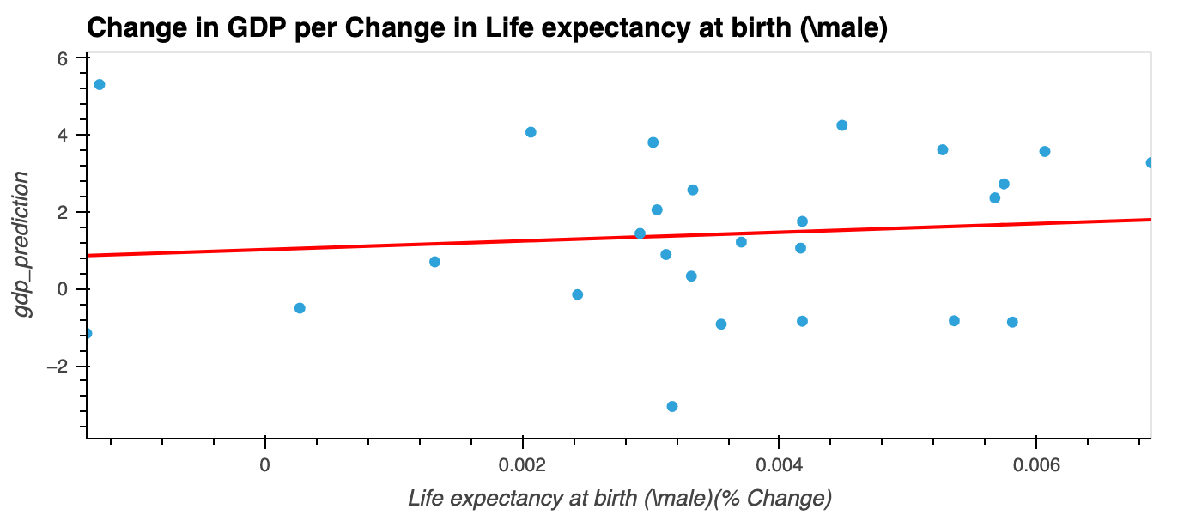
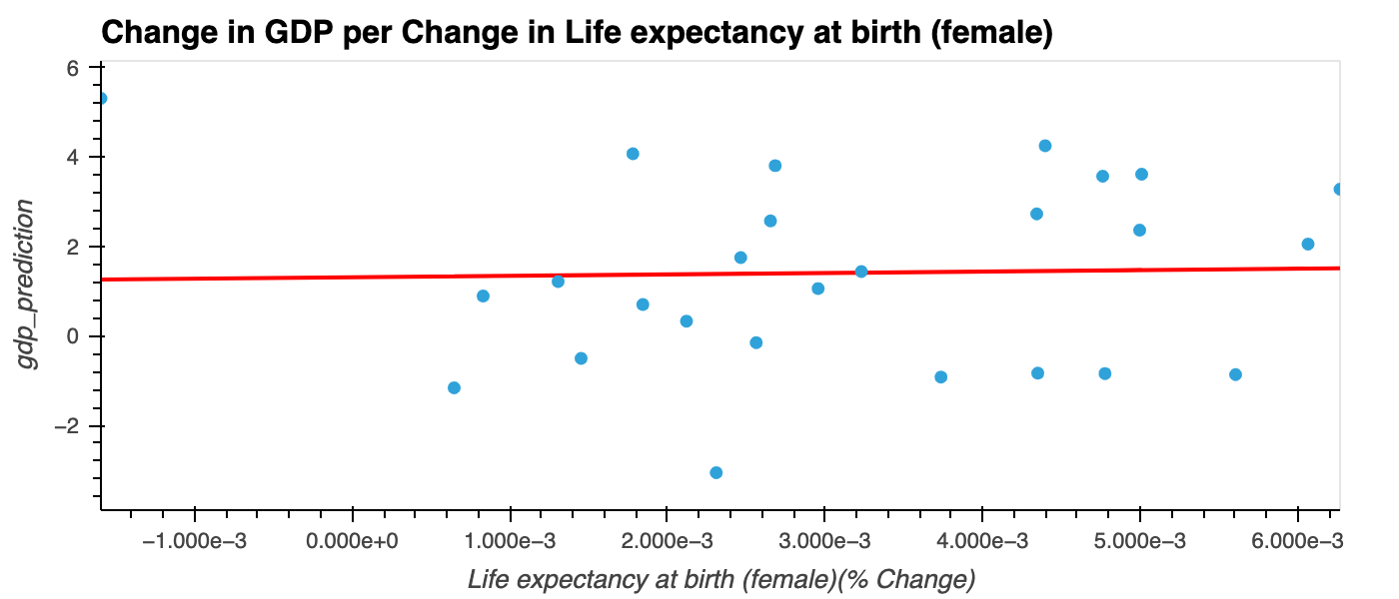

Slide 11
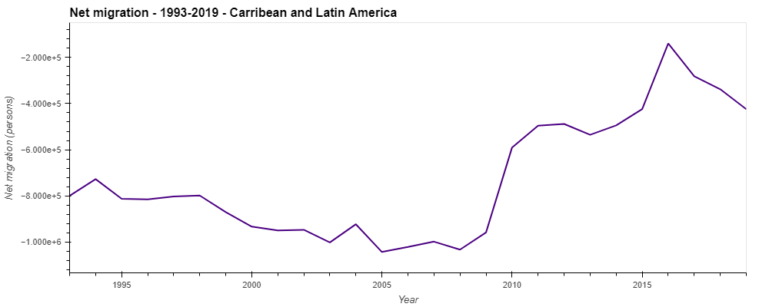
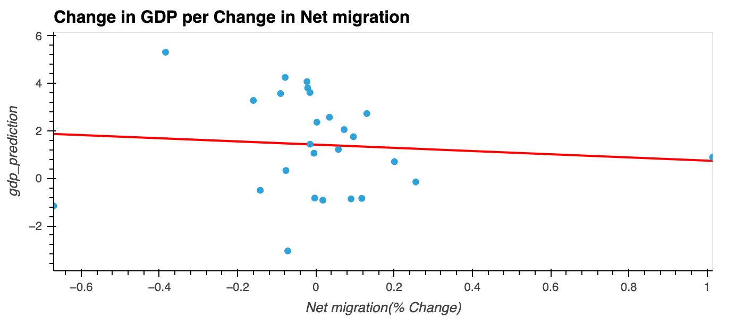

Slide 12
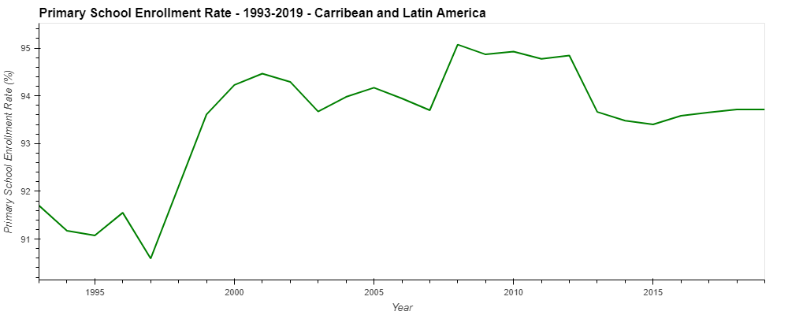
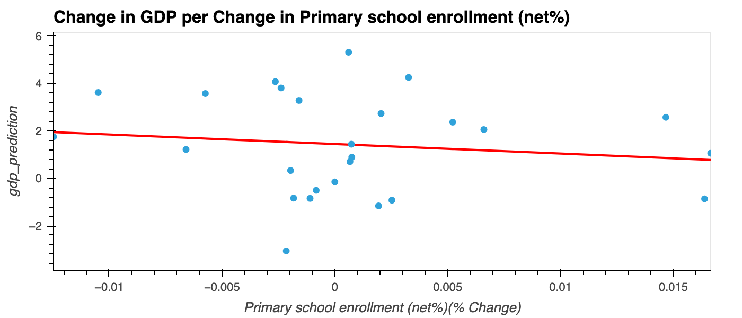

Slide 13
Models
Multi-Variable Linear Regression Analysis
Multi-Layer Perceptron Regression Analysis

Slide 14
Multi-Variable Linear Regression Analysis

Slide 15
Multivariable Linear Regression Analysis
GDP Growth Rate Per Capita(%) =
𝛽0 + 𝛽1 [Access to Electricity] + 𝛽2 [Literacy Rate(Adult Female)] + 𝛽3 [Literacy Rate(Youth Female)] +
𝛽4 [Literacy Rate(Adult Male)] + 𝛽5 [Literacy Rate(Youth Male)] + 𝛽6 [Life expectancy at Birth(Female)] +
𝛽7 [Life expectancy at Birth(Male)] + 𝛽8 [Primary School Enrollment] + 𝛽9 [Labor Force Participation (Female)] +
𝛽10 [Labor Force Participation (Male)] + 𝛽11 [Net Migration] + 𝜎t + g + 𝜖j,t,g

Slide 16
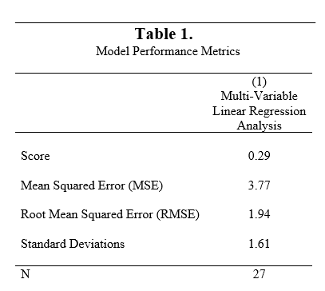
Results

Slide 17
Multi-Layer Perceptron Regression Analysis (Neural Networks)

Slide 18
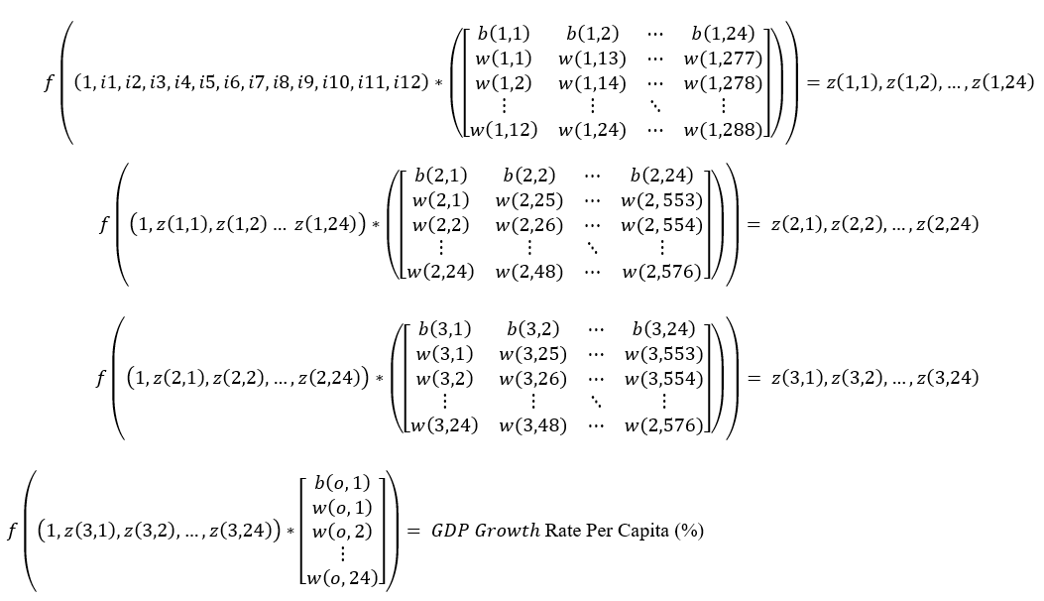
Multi-Layer Perceptron Regression Analysis
Function: sklearn.neural_network.MLPRegressor
(https://scikit-learn.org/stable/modules/generated/sklearn.neural_network.MLPRegressor.html)
Inputs: 12
Hidden Layers:
1: 24
2: 24
3: 24
Output layer: 1
Activation Function: Linear (f(x))
Soler: adam
Max_iter: 1000
See: https://www.youtube.com/watch?v=P8Xrj70qtyo

Slide 19
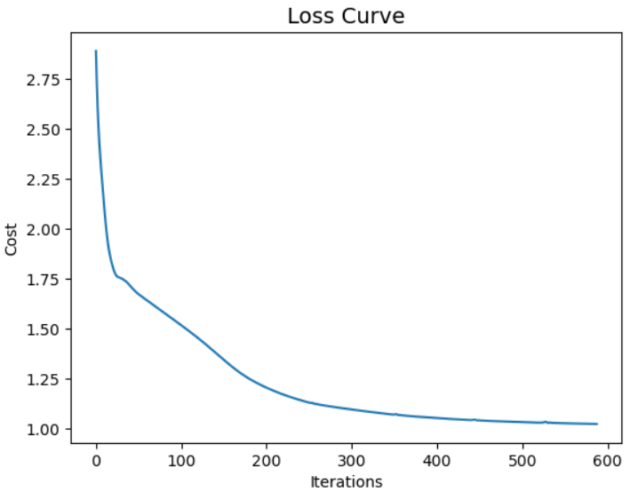
Results
Score: -5177548069.722707
r^2 Score: 0.06625829169346142.
Mean Squared Error: 3.5505980336622147.
Root Mean Squared Error: 1.8843030631143747.
Standard Deviation: 1.9500124087691886.

Slide 20
Partial Dependence
“Partial dependence plots (PDP) show the dependence between the target response and a set of input features of interest, marginalizing over the values of all other input features (the ‘complement’ features). Intuitively, we can interpret the partial dependence as the expected target response as a function of the input features of interest.”
Source: https://scikit-learn.org/stable/modules/partial_dependence.html
Shows the marginal effect a given feature has on the predicted output
* calculated with scaled training data

Slide 21
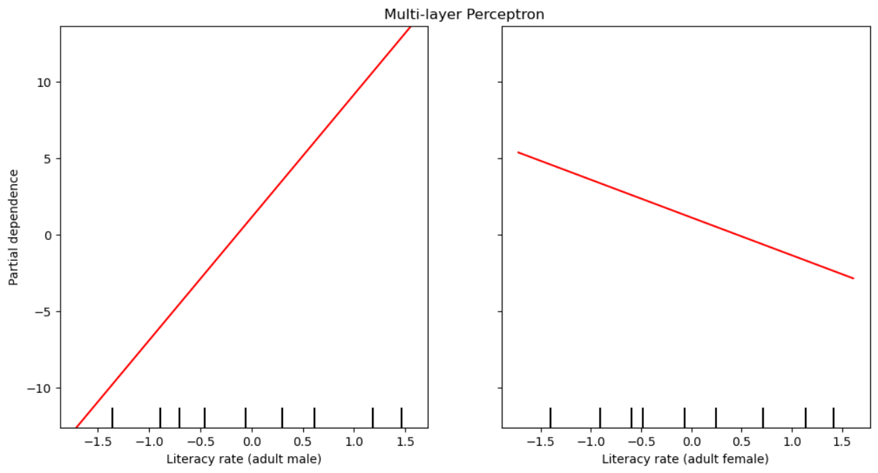
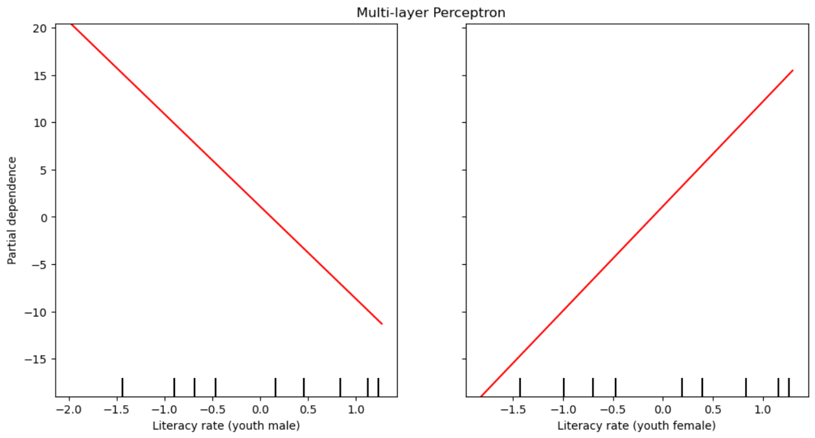

Slide 22
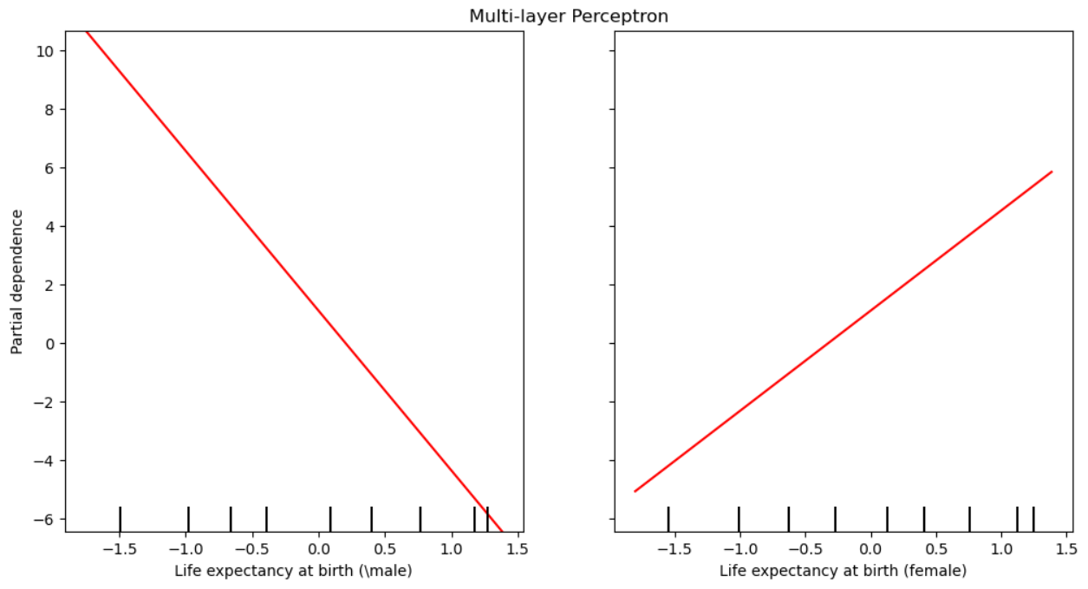
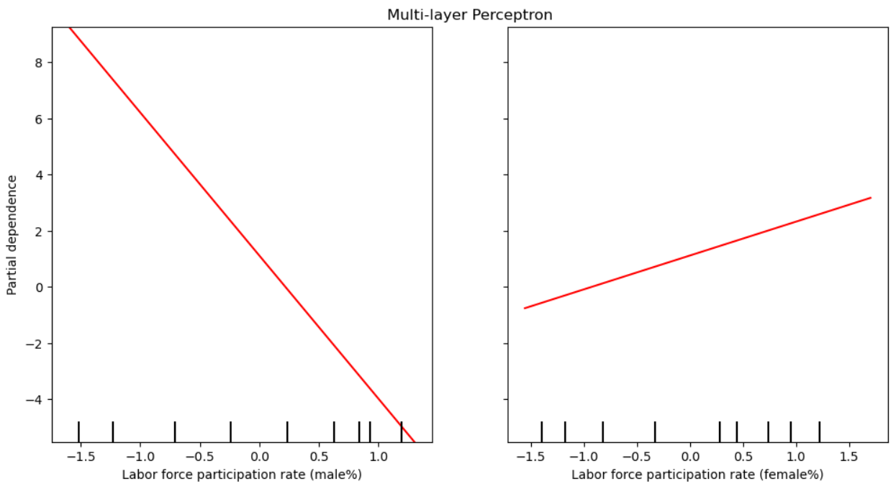

Slide 23
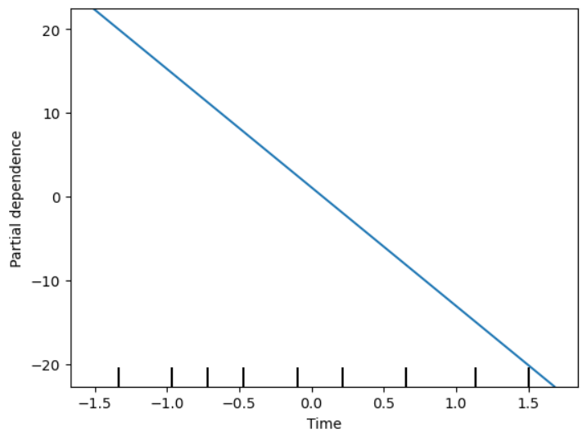
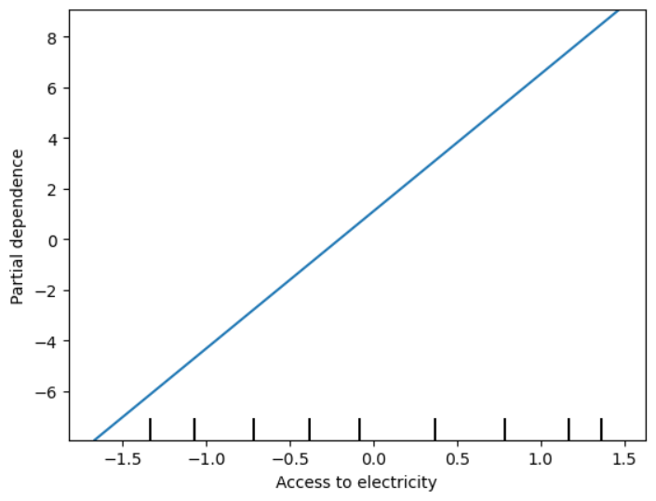
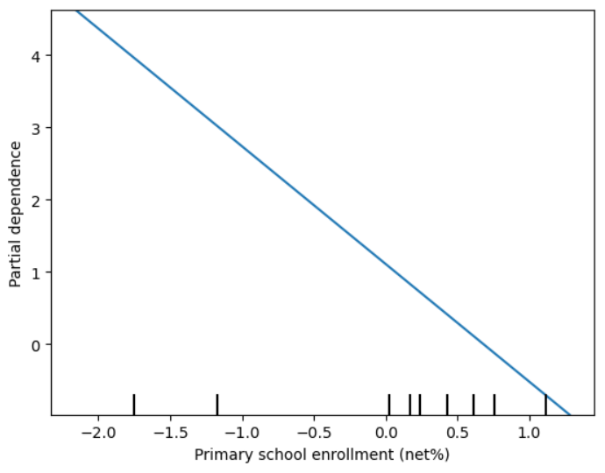
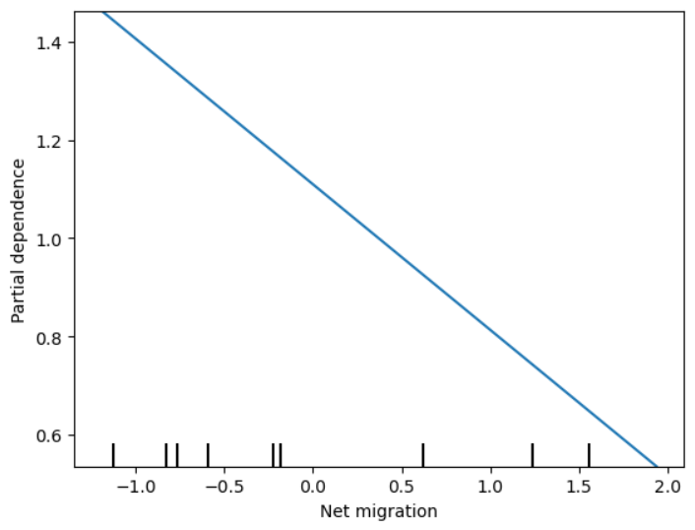

Slide 24
Results
The analysis did not determine a strong relationship between the Social Factors and Economic Development
Why?
Latin America and Caribbean have high Social Development, which could be past a critical point where additional growth in Social Development may not have a proportional impact on Economic Development
The Dataset constituted of only 27 years (1993-2020) which provides a limited number of observations to fully understand the relationship between Social and Economic development.
Social Development is very complex and cannot be easily captured by a finite set of variables.

Slide 25
Next Steps
Study developing regions and/or countries with lower levels of Social Development since, theoretically, the Social and Economic Development would have a stronger correlation.
Find other data sources which provide a greater number of observations.
Use different sets of Social Development factors to better capture the impact of Social Development on Economic Development

Slide 26
Links
Github Repo:
https://github.com/SamCFarrell/Determinants-of-GDP.git
Data Source:
https://databank.worldbank.org/source/world-development-indicators

Slide 27
Questions, thoughts or feedback?

